Slide 1

Navigation
Slide A
Recap Our Learning
What We Have Discovered
Last class we made a big discovery about peak forces in a collision.
Let’s take some time to look back and make a record of what we have discovered.
Turn to your Progress Tracker and help your teacher make a list of what we have discovered so far!
Notes:
Recall previous lessons. Project slide A. Say, Last class we figured out that the peak forces are equal on each cart during a collision, regardless of the mass or speed of the individual carts. It’s always an equal force, but in an opposite direction. We have also figured out a lot of other important ideas along the way! Let’s look back and see what we have learned so far.
Instruct students to look back at their Progress Trackers. Display the What We Have Discovered poster. Ask students to share what we have learned so far. Record student responses on the chart paper. Potential responses include the following:
Sometimes objects get damaged in collisions, other times objects are not damaged.
All objects have an elastic limit.
The elastic limit is the point to which objects can spring back to their original position after a collision.
If an object goes past its elastic limit, it will reach its breaking point.
Energy is transferred in a collision.
Energy transfer can make objects change shape.
Contact forces cause a change in shape.
All solid objects bend or change shape when any amount of contact force is applied to them.
The amount an object deforms depends on the type of materials it is made of, how thick it is, and its shape.
There are forces applied to each object when they are touching during a collision.
The amount of the contact forces is equal on the objects that are colliding but opposite in direction.
The peak forces can help determine if an object gets damaged.
If the peak force is more than the elastic limit, the object will reach its breaking point
An increase in kinetic energy due to a speed or mass increase will increase the size of the peak forces between the objects in a collision.
Say, Wow, we have figured out a lot! I think if we look back at our Driving Question Board we may be able to make progress on answering some of our questions.

Slide 2


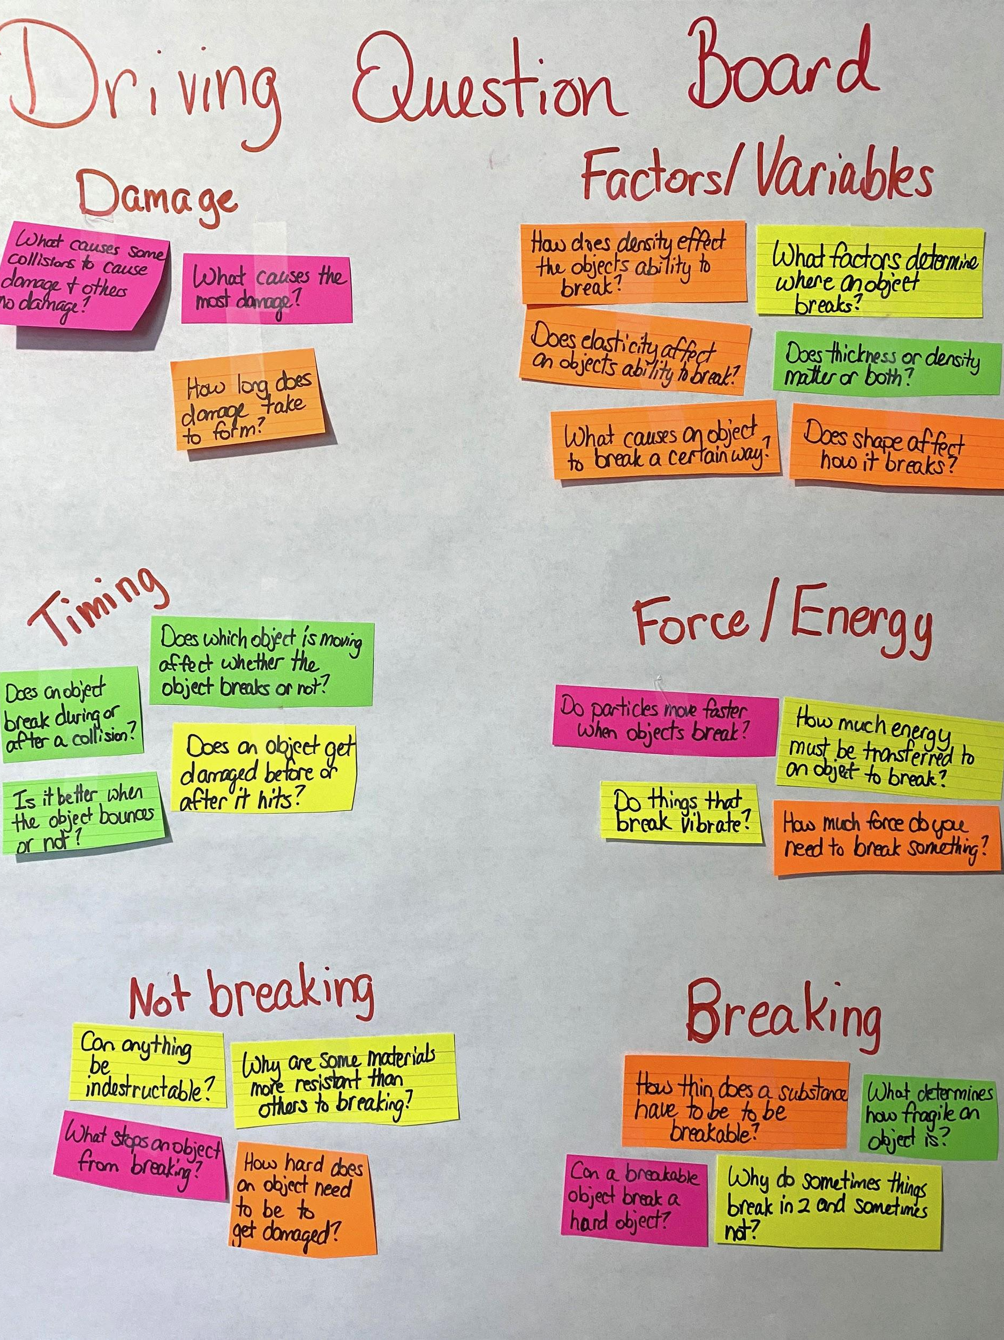
Revisit the Driving Question Board
Slide B
Driving Question Board Check-in
Look over the list of questions from the Driving Question Board.
With a partner, use your handout to identify at least 3 questions we have made progress on in our unit.
Pick one question to answer and be sure to cite evidence from our past activities and investigations in your answer.
Notes:
Review Driving Question Board questions. Project slide B. Distribute the Driving Question Board typed questions list you made from Lesson 1. If you plan to re-use these from class to class, then tell students not to mark on these handouts, but to make notes on the handout they will receive. Ask students to spend a moment looking over the list of questions.
Distribute the Reviewing Our Driving Question Board handout. Tell students they will spend some time working with a partner on identifying at least questions they feel the class has made progress on and one question they feel they can answer from our Driving Question Board. Go over the handout before allowing students to begin.
Circulate the room as students work in pairs to answer a question from the Driving Question Board. Listen carefully to student answers and listen for students to use science ideas to support their answers. If students are not using their science ideas to fully answer questions, use questioning to help students make the connection to their science ideas:
What evidence do we have from past investigations that supports your answer?
What patterns in past investigations and activities led you to that idea?
What patterns in data support your answer?
Did we collect any other data or evidence besides the piece you cited that helps support your answer?
Is there anything on our What We Have Discovered poster that helps you answer this question?
Did you see something change in our system as two objects interact in a previous investigation or activity that supports this answer? What happened?

Slide 3
Driving Question Board Debrief
Slide C
Checking on Our Progress
How many of you can now answer a question that we could not answer at the beginning of the unit?
What questions do you now feel comfortable answering? What were your answers?
Were there any questions about mass and speed that we couldn’t answer yet? Which ones?
Notes:
Debrief the Driving Question Board. After about 10 minutes of work time, bring students back together as a whole group. Project slide C. Ask students the following questions.
How many of you can now answer a question that we could not answer at the beginning of the unit?
What questions do you now feel comfortable answering? What were your answers?
Were there any questions about mass and speed that we couldn’t answer yet? Which ones?
As students share their answers to questions from the Driving Question Board, it is possible that a student might share an incorrect answer. Do not automatically correct. Instead ask the class after each question if we agree or disagree with the answer. If students disagree with the answer, refer students to the What We Have Discovered poster and ask them to use our science ideas to justify if the answer is correct or incorrect.
Collect the copies of the Driving Question Board questions from students. Save these pages for students to use in a later lesson.
Say, It seems like we can answer some of our questions on our Driving Question Board, but we still also have some questions we need to answer. Before we move on and try to investigate those questions, let’s see if we can apply what we have learned so far to make sense of a new phenomenon.

Slide 4
Checking Our Understanding
Slide D
Lesson Assessment
Write your name on your assessment.
We will read over the questions together.
Questions 6-7 will help us figure out where to go next. Do your very best to explain your reasoning.
We will come back together to discuss our ideas about mass and speed at the end of class. Be ready to share your ideas.
Notes:
Say, I was reading and came across this scenario about headers being banned in soccer. How many of you know what a header is? Listen for students' responses. If students do not know what a header is, explain that a header is when a player strikes the ball using their head.
Say, There have been discussions to ban headers in youth sports because some people believe they are dangerous and can cause concussions. I thought we could dig into these ideas and see if we can explain using our science ideas if a header can actually cause a concussion and determine if there are other collisions that occur in soccer that can cause concussions as well.
Distribute Soccer Assessment. Project slide D. Direct students to put their names at the top of the paper and read questions 1-5 together. Answer any clarifying questions students may have about the assessment.
Once students understand what questions 1-5 are asking, read questions 6-7 of the assessment. Explain that the whole class will revisit the questions and answers from this section at the end of class. Tell the class to give their best guesses on questions 6-7 and to use experiences from real life and our prior investigations to help answer the questions. Questions 6-7 are not part of the assessment that we may be able to answer completely, but any ideas we have will help us determine our next steps as a class.
Ask students to complete Soccer Assessment on their own. Collect the assessment when students are finished.

Slide 5

Slide E
Arguing from Evidence
Whole-Group Discussion
If we were to compare one cart with double the mass and one cart with double the speed, would one have more kinetic energy than the other?
If you think one factor will increase kinetic energy more than the other, what do you think is a bigger factor contributing to damage in any collision: the speeds of the objects involved in the collision or the mass of the objects involved in the collision, and why?
Notes:
Discuss questions about mass and speed. Say, As I was walking around and looking at your assessments, it seems that we have different ideas about mass and speed. Let’s share some of our ideas about questions 6. Present slide E. Ask students to share their ideas about question 6.
Say, Wow, this is really interesting. We can all seem to agree that increasing the mass or the speed of a moving object would increase its kinetic energy which increases the peak forces in a collision. And we also agree this is related to the amount of damage in a collision. But where we have some disagreement is around which would increase the kinetic energy of an object more and the resulting damage from it hitting something else in a collision--doubling the mass of that moving object or doubling its speed. So it seems like we have something we need to figure out to better understand these relationships. I look forward to reading through some of the ideas you wrote down in question 7 for investigations that could help us figure that out. Let’s plan on investigating this question by pursuing some additional investigations and analyzing some additional source of data next time.

